Slide 1

ANALYSIS OF CUSTOMER SERVICE DATA
NILE E-COMMERCE PROJECT

Slide 2
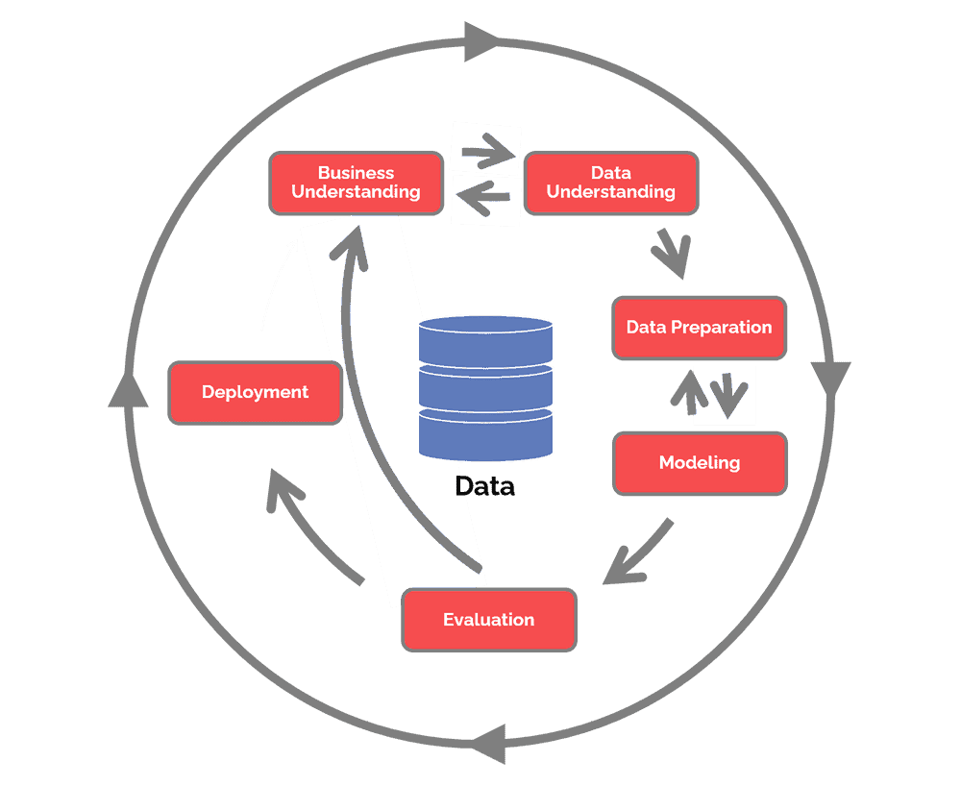
WE USING CRISP-DM APPROACH TO DATA-DRIVEN INSIGHTS AND ACTIONABLE RECOMMENDATIONS BASED ON SENTIMENT
ANALYSIS AND ROOT CAUSE IDENTIFICATION
CRISP-DM is a process model that serves as the base for a data science process. It has six sequential phases:
Business understanding – What does the business need?
Data understanding – What data do we have / need? Is it clean?
Data preparation – How do we organize the data for modeling?
Modeling – What modeling techniques should we apply?
Evaluation – Which model best meets the business objectives?
Deployment – How do stakeholders access the results?

Slide 3
Project Objective : The analysis aims to leverage data-driven approaches to optimize customer service processes, enhance customer experience, and drive overall business growth.
Customer Sentiment Analysis | Service Response Time Analysis | Customer Segmentation | Root Cause Analysis:
► Perform sentiment analysis on customer interactions. | ► Analyze response times for customer queries and support requests to assess the efficiency of the customer service team. | ► Segment customers based on their demographics, behavior, and preferences. | ► Investigate common customer complaints.
► Identify positive, negative, and neutral sentiments expressed by customers to understand overall satisfaction levels. |  | ► Understand different customer segments' needs and pain points to tailor services and communications accordingly. | ► Pinpoint recurring problems to address them proactively and prevent future escalations.

Slide 4
# SEMTIMENTAL ANALYSIS
DATA OVERVIEW
# TOTAL 32941 NO OF ENTRIES WE ARE HAVING IN OUR DATASET
# THERE ARE 5 TYPES OF SENTIMENTS RESPECTIVELY NEUTRAL, POSITIVE, VERY POSITIVE, NEGATIVE, VERY NEGATIVE THIS TYPES OF SENTIMENTS CUSTOMER.
SENTIMENTS CATAGORIES | SENTIMENTAL ANALYSIS
Negative | 33.58%
Neutral | 26.57%
Positive | 11.92%
Very Negative | 18.29%
Very Positive | 9.62%
• INSIGHTS
1) NEGATIVE AND VERY NEGATIVE COMBINEDLY AFFECT 52% OF TOTAL COMPLAINTS .
2) IT SHOWING NEGATIVE TRENDS OF DATASETS AGAINST COMPANIES SERVICE PROCESSES

Slide 5
#REASONWISE SEMTIMENTAL ANALYSIS
DATA OVERVIEW
# THERE ARE MAINLY THREE REASONS OF CUSTOMER COMPLAINTS BILLING QUESTIONS, PAYMENTS &SERVICE OUTAGE
INSIGHT
BILLING QUESTIONS TAKES 71% OF CUSTOMERS COMPLAITS,
REAMENING 29% CONTAINS SERVICE OUTRAGE & PAYMENTS
52% OF EVERY REASONS SENTIMENT HAS BEEN FOUND IN NEGATIVE SENTIMENT.
SENTIMENTAL OVERVIEW
REASONS / SENTIMENTS | BILLING QUESTION | PAYMENTS | SERVICE OUTAGE
NEGATIVE | 23.89% | 4.84% | 4.86%
NEUTRAL | 18.92% | 3.76% | 3.90%
POSITIVE | 8.42% | 1.68% | 1.82%
VERY NEGATIVE | 13.05% | 2.72% | 2.52%
VERY POSITIVE | 6.94% | 1.42% | 1.26%
GRAND TOTAL | 71.22% | 14.42% | 14.36%

Slide 6
# CALL_CENTER WISE SEMTIMENTAL ANALYSIS WITH RESPECT TO REASON
DATA OVERVIEW
# THERE ARE TOTAL 4 CALL CENTER WORKING IN COUNTRY IN WHICH. WE HAVE TAKE SENTIMENTAL ANALYSIS WITH RESPECT TO REASONS
INSIGHT
MOSTLY 52% OF EVERY REASONS SENTIMENT HAS BEEN FOUND IN NEGATIVE IN EVERY REASON AT WITH RESPECT TO CALL CENTER
BUT WE FOUND THAT THERE ARE HUGE DECREASE IN NEGATIVE SENTIMENT AT DENVER CALLCENTER WHILE ATTENDING PAYMENT RELATED ISSUES.
SLIGHT INCREASE IN POSITIVE SENTIMENT AT CHICAGO WHILE ATTENDING ATTENDING PAYMENT RELATED ISSUES.
REASON | Negative | Neutral | Positive | Very Negative | Very Positive | NEGATIVE | POSITIVE
Baltimore/MD | 35.13% | 25.35% | 11.82% | 18.17% | 9.53% | 53% | 21%
Chicago/IL | 34.13% | 25.31% | 13.10% | 17.51% | 9.95% | 52% | 23%
Denver/CO | 30.33% | 32.39% | 10.80% | 16.45% | 10.03% | 47% | 21%
Los Angeles/CA | 32.68% | 25.70% | 11.04% | 20.48% | 10.09% | 53% | 21%
Grand Total | 33.54% | 26.07% | 11.62% | 18.89% | 9.88%

Slide 7
# SEMTIMENTAL ANALYSIS WITH CALL DURATION
DATA OVERVIEW
# THERE ARE WE CATAGORIES ALL DATA IN 8 GROUPS CALL DURATION. AFTER THAT WE GET A DETAILED INFORMATION REGARDING
RELATION BETWEEN CALL DURATION AND SENTIMENT
INSIGHT
WE FOUND THAT THERE ARE NOTICIBLE EVIDENCE FOR TO SAY THAT CALL DURATION 16 TO 20 ARE ENOUGH AND APPROPRIATE TIME TO RESOLVE QUERIES.
- LOW IN NEGATIVE AND HIGH IN POSITIVE RATING.
2) THE MORE TIME TAKES TO RESOLVE ISSUE CUSTOMER GIVING MORE NAGATIVE IVALUE
EXAMPLE - 36 TO 40 & 4O TO 45
3) AVERAGE CALL DURATION 25 MINS
# SEMTIMENTAL ANALYSIS WITH CALL DURATION
CALL DURATION | Negative | Neutral | Positive | Very Negative | Very Positive
21 to 25 | 33.97% | 27.34% | 11.09% | 17.86% | 9.73%
36 to 40 | 35.35% | 25.40% | 11.91% | 18.16% | 9.18%
5 to 10 | 33.46% | 26.29% | 12.22% | 18.69% | 9.34%
11 to 15 | 32.81% | 27.53% | 11.57% | 18.05% | 10.04%
16 to 20 | 32.05% | 26.27% | 12.75% | 18.52% | 10.41%
26 to 30 | 32.89% | 26.41% | 12.16% | 18.88% | 9.66%
31 to 35 | 33.23% | 27.06% | 12.45% | 17.92% | 9.34%
41 to 45 | 34.98% | 26.40% | 11.14% | 18.14% | 9.33%
Grand Total | 33.58% | 26.57% | 11.92% | 18.29% | 9.62%

Slide 8
# RESPONSE TIME TO ATTNED BILLING QUESTIONS WITH RESPECT TO CHANNEL
Row Labels | Above SLA | Below SLA | Within SLA
Call-Center | 12.58% | 24.69% | 62.73%
Chatbot | 12.37% | 24.11% | 63.51%
Email | 12.71% | 24.37% | 62.92%
Web | 13.45% | 25.04% | 61.51%
Row Labels | Above SLA | Below SLA | Within SLA
Call-Center | 11.98% | 25.71% | 62.31%
Row Labels | Above SLA | Below SLA | Within SLA
Chatbot | 13.55% | 25.05% | 61.40%
Email | 11.79% | 24.47% | 63.73%
Web | 12.16% | 23.95% | 63.90%
INSIGHT
OVERALL HIGH SLA MAINTAIN BY SERVICE TEAM, BY DESCRIBING ABOVE CHART WE FOUND THAT FOR BILLING ISSUES RESPONSE TIME IS GOOD BY USING CHATBOT AND NOT GOOD SLA BY USING WEB.
WE ALSO FOUND THAT CHATBOT IS NOT RECOMMENDED FOR ATTENDING SERVICE OUTRAGE ISSUES.
PAYMENT ISSUES ONLY RESPONBED BY USING CALL CENTER AND IT HAS MAINTAIN LOW ABOVE SLA RESPONSE TIME.

Slide 9
# ABOVE SLA RESPONSE TIME WITH RESPECT TO CHANNEL AND REASON
RESPONSE TIME | EFFICIENCY
ABOVE SLA | 12.65%
BELOW SLA | 24.74%
WITHIN SLA | 62.61%
RESPONSE TIME | ABOVE SLA | BELOW SLA | WITHIN SLA
Call-Center | 12.58% | 24.69% | 62.73%
Los Angeles | 12.28% | 23.78% | 63.94%
Baltimore | 12.82% | 25.32% | 61.86%
Chicago | 13.18% | 24.44% | 62.37%
Denver | 11.98% | 27.11% | 60.90%
CHATBOT | 12.37% | 24.11% | 63.51%
LOS ANGELES/CA | 12.55% | 24.07% | 63.37%
BALTIMORE/MD | 12.39% | 24.03% | 63.58%
CHICAGO/IL | 11.61% | 24.69% | 63.70%
DENVER/CO | 12.85% | 23.53% | 63.62%
INSIGHT
Overall high SLA maintain by service team, there are no direct relationship between SLA and Sentiments.
By describing above chart we found that Denver call-center has good records to handle billing questions on telephonic channel.
we also found that overall within SLA response time of Chatbot is high than every other channel

Slide 10
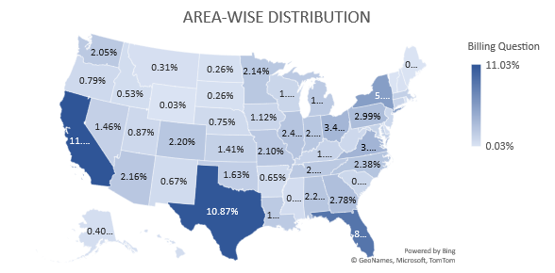
# OUTRAGE PER CALL CENTER WITH RESPECT TO EFFICIENCY RESPECT TO BILLING REASONS
Row Labels | Billing Question | Payments | Service Outage
California | 11.03% | 10.55% | 11.46%
Texas | 10.87% | 10.68% | 10.87%
Florida | 8.59% | 8.80% | 8.48%
New York | 5.40% | 5.62% | 5.33%
Virginia | 3.64% | 3.16% | 3.38%
INSIGHT
Out of 52 states, 5 states has more than 40 % of Service issues with respect to its particular reason.
Company has to be more dedicated & focus on this 5 states.
REASONS | Baltimore | Chicago | Denver | Los Angeles
Billing Question | 33.45% | 16.43% | 8.43% | 41.69%
Payments | 33.14% | 16.72% | 8.19% | 41.95%
Service Outage | 33.62% | 16.28% | 8.65% | 41.46%

Slide 11
# OVERALL ROOT CAUSE ANALYSIS & RECCOMANDATION
SUMMERY
THERE ARE MEASURE PROBLEM FOUND IN BILLING SOFTWARE OR DATABASE OF THE COMPANY.
BY MAINTANING GOOD SLA ALSO THEY NOT ABLE TO CHAGE CUSTOMER SENTIMENT BECAUSE OF HIGH BILLING ISSUES.
CHATBOT HAS SLIGHTLY UPPER HAND IN RESPONSE COMPLAINTS WITHIN SLA & CALL CENTER HAS GOOD RECORDS IN RECTIFY PAYMENT & BILLING COMPLAITS, SO WE HAVE TO MAKE HUGE CHANGE AND COMBINE THIS BOTH CHANNELS TO ATTEND BILLING ISSUES.
IN TIME ANALYSIS WE FOUND THAT TO ATTEND, ADDRESS & RECTIFY THIS ISSUES EXECUTIVE NEED TO HAVE AN STANDARD 16 TO 20 MIN TIME-FRAME, WHICH GIVES CUSTOMER OVERALL SATISFACTION FOR THE SERVICE CALL.
COMPANY HAS TO FOCUS ON ITS TOP 5 STATES TO CHAGE ITS NEGATIVE SENTIMENTS IN MARKET.

